Slide 1
Work, energy and power
Pre-class (1 to 13)
in-class (15 onwardS)

Slide 2
An alternative approach to mechanics
Many problems in mechanics involve forces which are not constant.
Solving this type of problems using Newton’s laws can be very difficult.
An alternate method based on the concepts of work, energy and power can greatly simplify calculations.

Slide 3
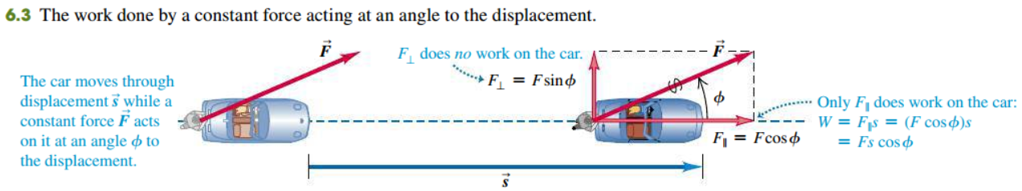

Work done by a constant force
The work done by a constant force is defined as $W=\vec{F}⋅\vec{s}=Fs\cos{φ}$ where $φ$ is the angle between the force and the displacement.

Slide 4
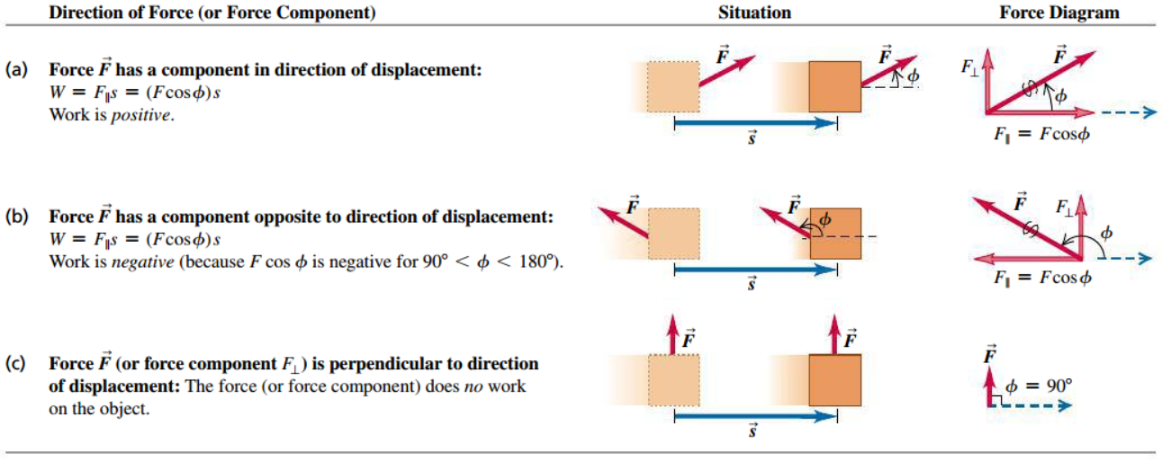
Work can be positive, negative or zero

Slide 5
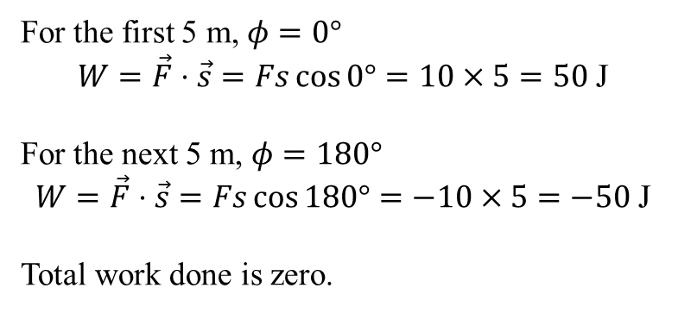
Example 1
The diagram shows a force-displacement graph of an object. The force acts in the direction of the displacement for the first 5 m and opposite to the displacement in the next 5 m. What is the work done for the whole journey?
F / N
For the first 5 m, $φ=0°$
$$W=\vec{F}⋅\vec{s}=Fs\cos{0°}=10×5=50 \text{J}$$
For the next 5 m, $φ=180°$
$$W=\vec{F}⋅\vec{s}=Fs\cos{180°}=−10×5=−50 \text{J}$$
Total work done is zero.
10
s / m
5
10
-10

Slide 6
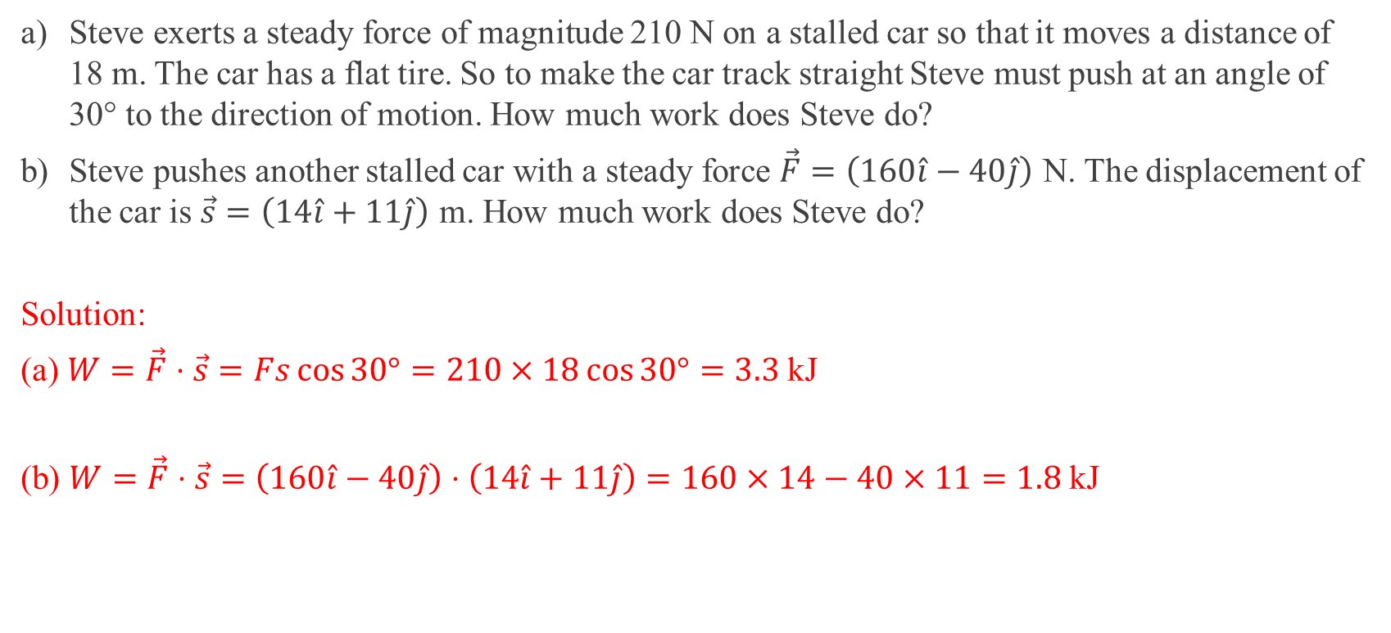
Example 2
a) Steve exerts a steady force of magnitude 210 N on a stalled car so that it moves a distance of 18 m. The car has a flat tire. So to make the car track straight Steve must push at an angle of 30° to the direction of motion. How much work does Steve do?
b) Steve pushes another stalled car with a steady force $\vec{F}=\left(160\hat{i}−40\hat{j}\right)$ N. The displacement of the car is $\vec{s}=\left(14\hat{i}+11\hat{j}\right)$ m. How much work does Steve do?
Solution:
(a) $W=\vec{F}⋅\vec{s}=Fs\cos{30°}=210×18\cos{30°}=3.3 \text{kJ}$
(b) $W=\vec{F}⋅\vec{s}=\left(160\hat{i}−40\hat{j}\right)⋅\left(14\hat{i}+11\hat{j}\right)=160×14−40×11=1.8 \text{kJ}$
Notes:
a) W = 3.3 × 10³ J b) W = 1.8 × 10³ J

Slide 7
Work due to many forces
If there are many forces acting on an object, we can use one of the following two approaches to calculate the total work :
i) Compute the work done by each separate force and add them together.
ii) Compute the net force (vector sum) and find the work done by the net force.

Slide 8
Energy
Energy is defined as the ability to do work.
Hence, energy and work are equivalent.
The SI unit of energy is the joule (J).
The different types of energy are light, heat, sound, electrical, chemical and mechanical.
Mechanical energy comprises kinetic energy and potential energy.

Slide 9
Principle of conservation of energy
The principle of conservation of energy states that energy
can neither be created nor destroyed in any process.
can be converted from one type to another (including work).
can be transferred from one body to another with the total amount remaining constant.
The total energy of an isolated system (one that is not interacting with other systems) is constant.

Slide 10
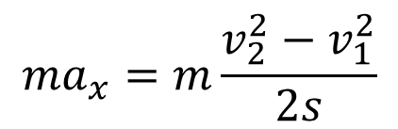
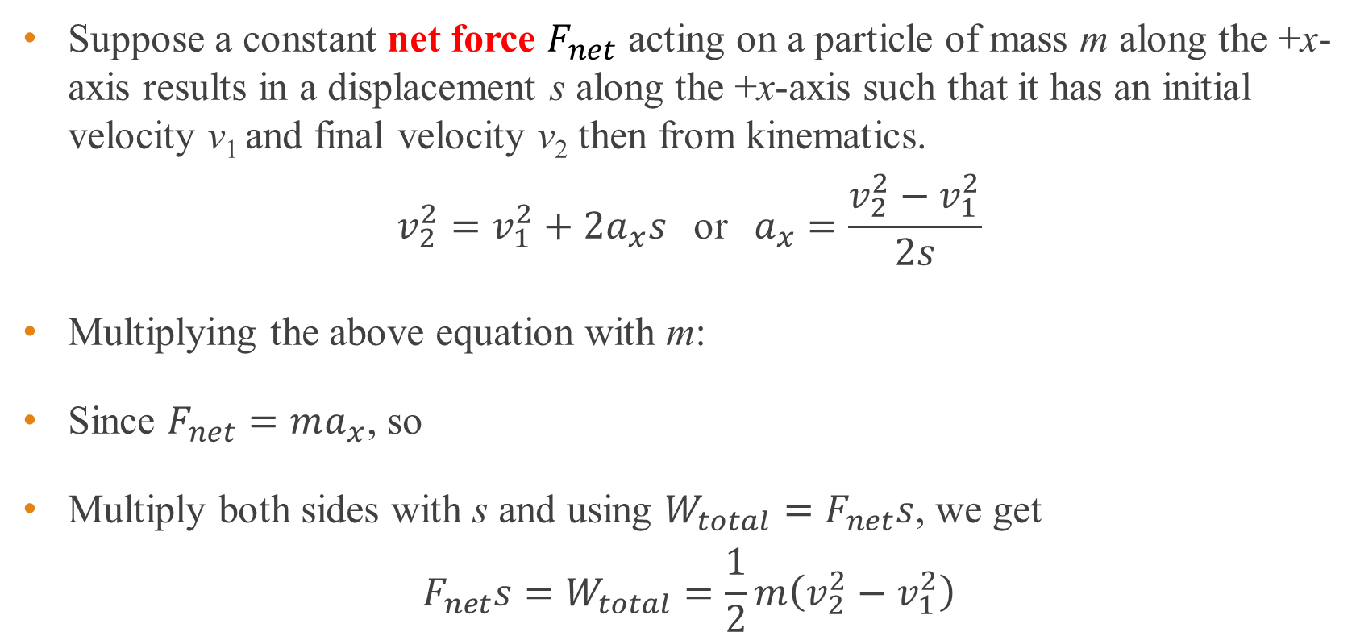
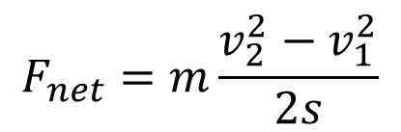
Total Work
Suppose a constant net force $F_{net}$ acting on a particle of mass m along the +x-axis results in a displacement s along the +x-axis such that it has an initial velocity v₁ and final velocity v₂ then from kinematics.
$$v_{2}^{2}=v_{1}^{2}+2a_{x}s \text{or} a_{x}=\frac{v_{2}^{2}−v_{1}^{2}}{2s}$$
Multiplying the above equation with m:
Since $F_{net}=ma_{x}$, so
Multiply both sides with s and using $W_{total}=F_{net}s$, we get
$$F_{net}s=W_{total}=\frac{1}{2}m\left(v_{2}^{2}−v_{1}^{2}\right)$$
$$ma_{x}=m\frac{v_{2}^{2}−v_{1}^{2}}{2s}$$
$$F_{net}=m\frac{v_{2}^{2}−v_{1}^{2}}{2s}$$

Slide 11
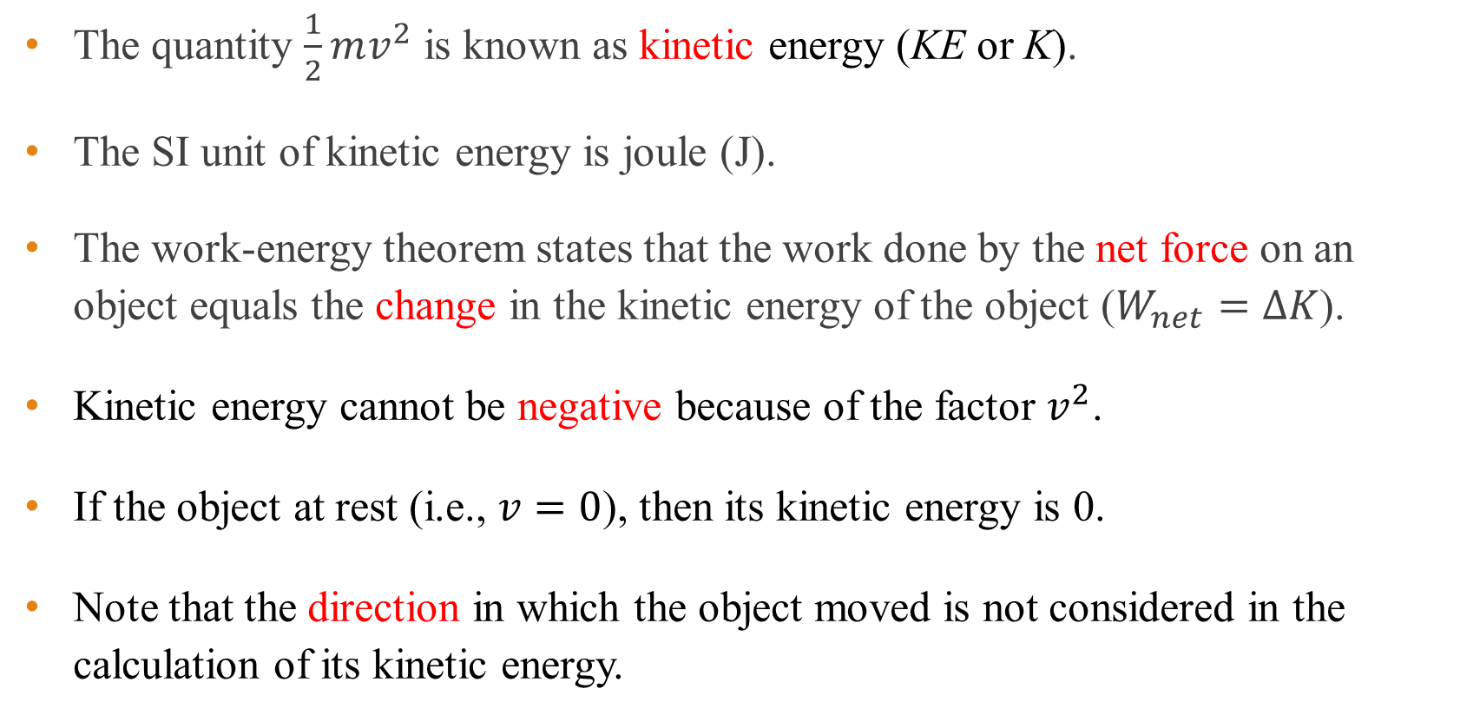
Kinetic energy and Work-energy theorem
The quantity $\frac{1}{2}mv^{2}$ is known as kinetic energy (KE or K).
The SI unit of kinetic energy is joule (J).
The work-energy theorem states that the work done by the net force on an object equals the change in the kinetic energy of the object ($W_{net}=ΔK$).
Kinetic energy cannot be negative because of the factor $v^{2}$.
If the object at rest (i.e., $v=0$), then its kinetic energy is 0.
Note that the direction in which the object moved is not considered in the calculation of its kinetic energy.

Slide 12
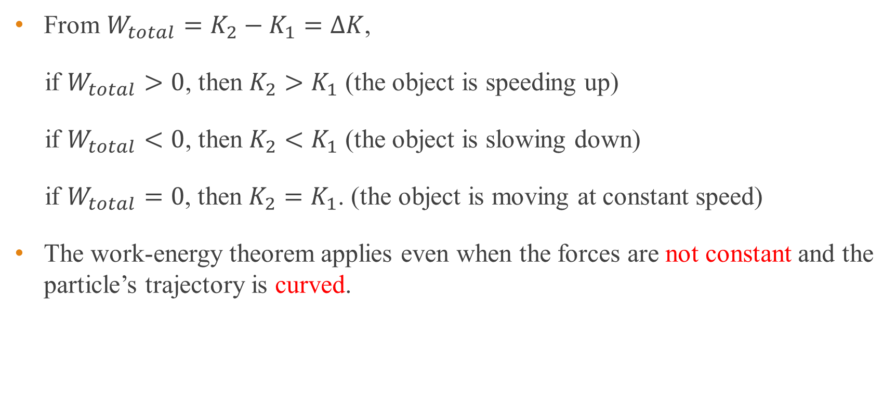
Work-energy theorem
From $W_{total}=K_{2}−K_{1}=ΔK$,
if $W_{total}>0$, then $K_{2}>K_{1}$ (the object is speeding up)
if $W_{total}<0$, then $K_{2}<K_{1}$ (the object is slowing down)
if $W_{total}=0$, then $K_{2}=K_{1}$. (the object is moving at constant speed)
The work-energy theorem applies even when the forces are not constant and the particle’s trajectory is curved.

Slide 13
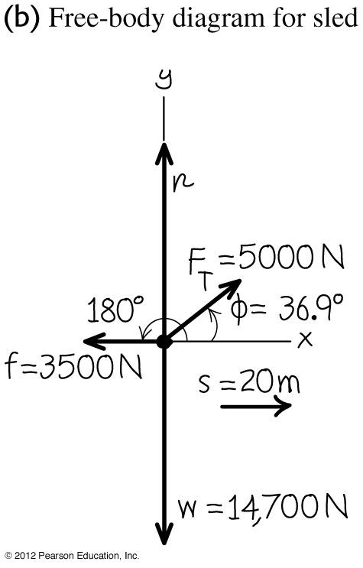
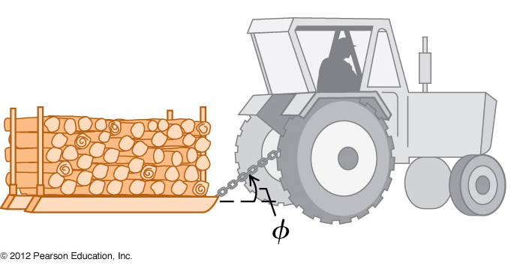

Example 3
A farmer hitches his tractor to a sled loaded with firewood and pulls it a distance of 20 m along level ground (see figure). The total weight of the sled and load is 14700 N. The tractor exerts a constant force of 5000 N at an angle of 36.9° above the horizontal. A friction force of 3500 N opposes the sled’s motion. (a) Find the work done by each force acting on the sled and (b) the total work done by all the forces. (c) Suppose the sled’s initial speed is 2.0 m/s. What is the speed of the sled after it moves 20.0 m?
(a) $W_{\text{weight}}=W_{\text{normal}}=0$ (angle between force and s is 90$°$)
$W_{\text{friction}}=3500×20×\cos{180°}=−70$kJ
$W_{\text{tractor}}=5000×20×\cos{36.9°}=80$ kJ
(b) $W_{\text{total}}=0+0+80$ kJ $−70$ kJ $=10$ kJ
(c) Mass of sled, $m=\frac{W}{g}=\frac{14700}{9.80}=1500$ kg
By work-energy theorem, $W_{\text{total}}=ΔK$
$$10000=\frac{1}{2}\left(1500\right)\left(v^{2}−2^{2}\right)$$
Hence $v=4.2$ m/s
Notes:
a) W_{Tractor} = 80 × 10³ J, W_{friction} = -70 × 10³ J , W_{weight}= 0 J, W_{normal}= 0 J b) W_{total} = 10 × 10³ J c) v = 4.2 m/s

Slide 14
End of pre-class slides

Slide 15

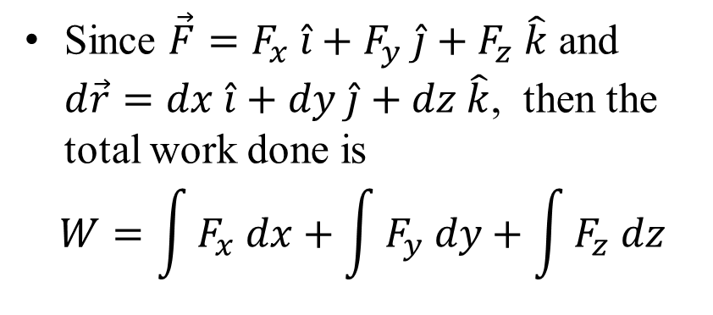
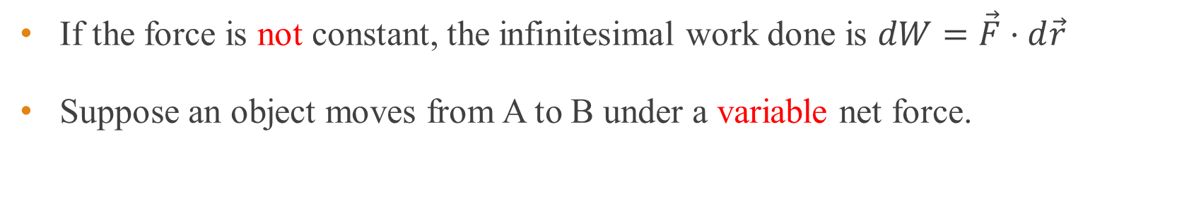



Work done by non-constant force
If the force is not constant, the infinitesimal work done is $dW=\vec{F}⋅d\vec{r}$
Suppose an object moves from A to B under a variable net force.
y
Since $\vec{F}=F_{x} \hat{i}+F_{y} \hat{j}+F_{z} \hat{k}$ and $d\vec{r}=dx \hat{i}+dy \hat{j}+dz \hat{k}$, then the total work done is
$$W=\int{F_{x} dx}+\int{F_{y} dy}+\int{F_{z} dz}$$
$$\vec{F}$$
$$d\vec{r}$$
A
B
$${\vec{r}}_{1}$$
$${\vec{r}}_{2}$$
x

Slide 16
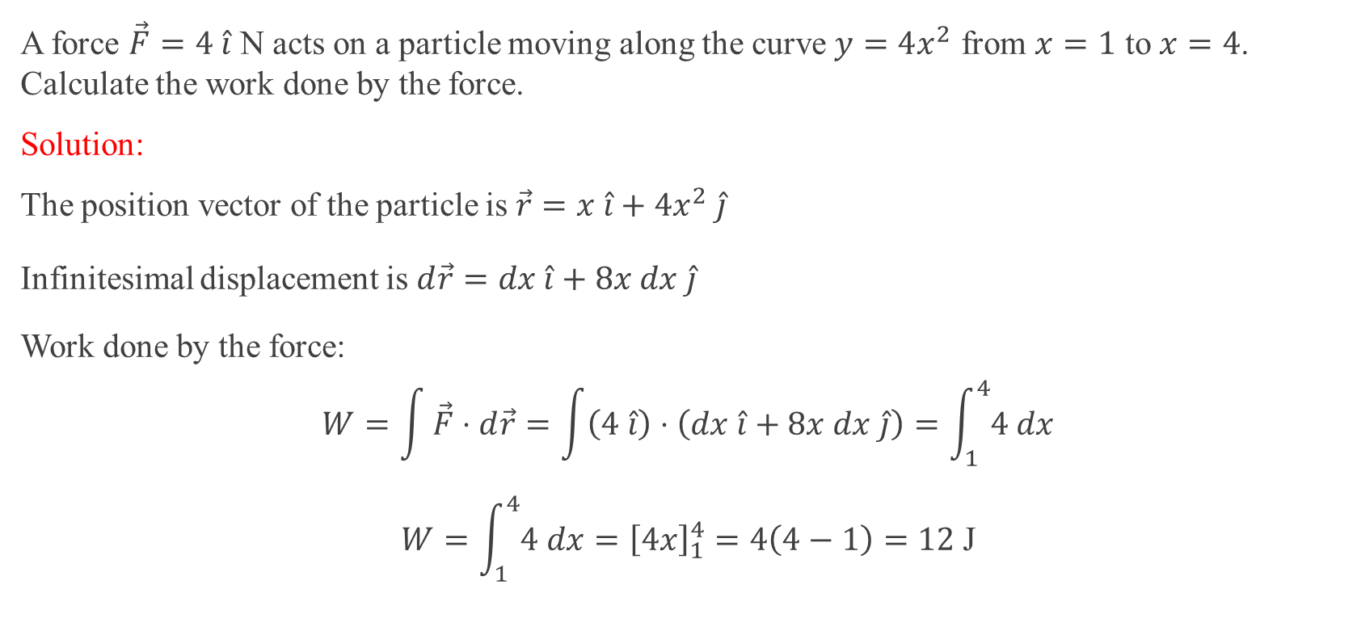
Example 4
A force $\vec{F}=4 \hat{i}$ N acts on a particle moving along the curve $y=4x^{2}$ from $x=1$ to $x=4$. Calculate the work done by the force.
Solution:
The position vector of the particle is $\vec{r}=x \hat{i}+4x^{2} \hat{j}$
Infinitesimal displacement is $d\vec{r}=dx \hat{i}+8x dx \hat{j}$
Work done by the force:
$$W=\int{\vec{F}⋅d\vec{r}}=\int{\left(4 \hat{i}\right)⋅\left(dx \hat{i}+8x dx \hat{j}\right)}=\int_{1}^{4}{4 dx}$$
$$W=\int_{1}^{4}{4 dx}={\left[4x\right]}_{1}^{4}=4\left(4−1\right)=12 \text{J}$$

Slide 17
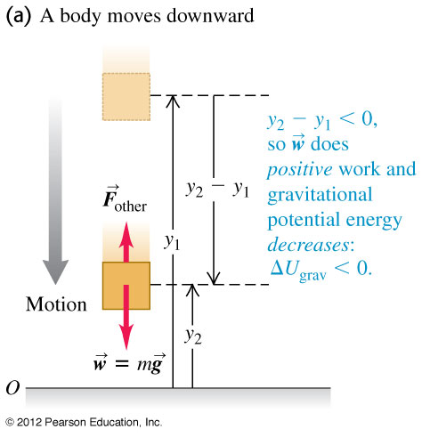
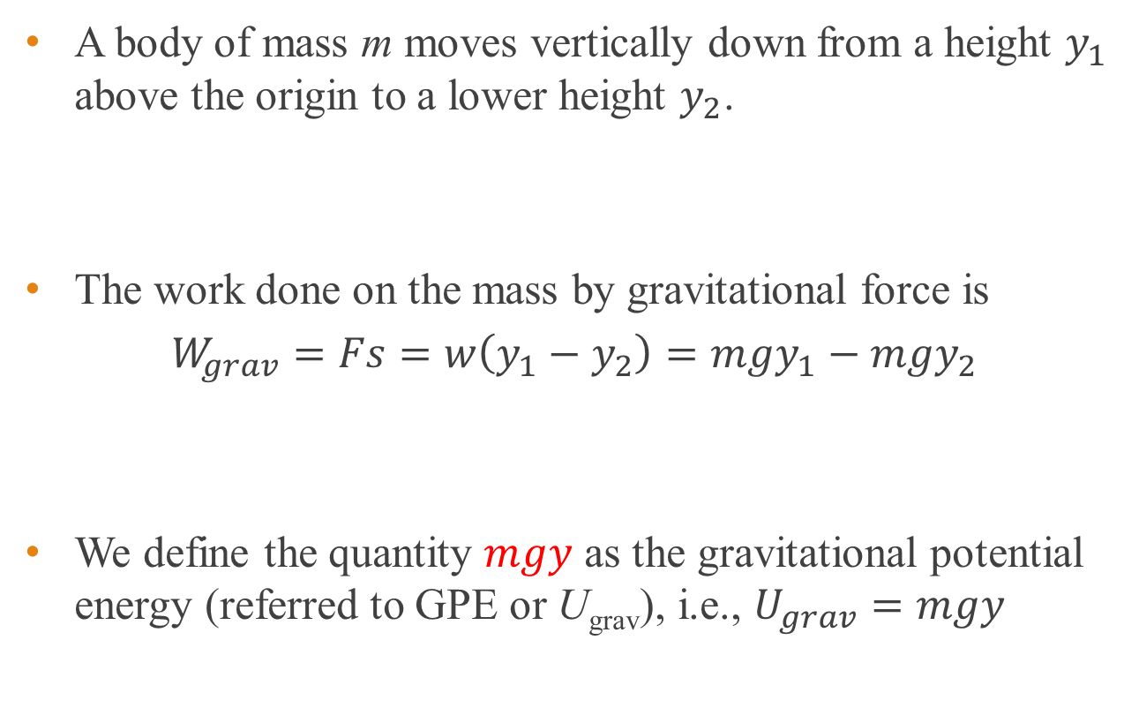
Work and Gravitational Potential Energy
A body of mass m moves vertically down from a height $y_{1}$ above the origin to a lower height $y_{2}$.
The work done on the mass by gravitational force is
$$W_{grav}=Fs=w\left(y_{1}−y_{2}\right)=mgy_{1}−mgy_{2}$$
We define the quantity $mgy$ as the gravitational potential energy (referred to GPE or U_{grav}), i.e., $U_{grav}=mgy$
Notes:
The above expression is true even if the body moves upward.

Slide 18
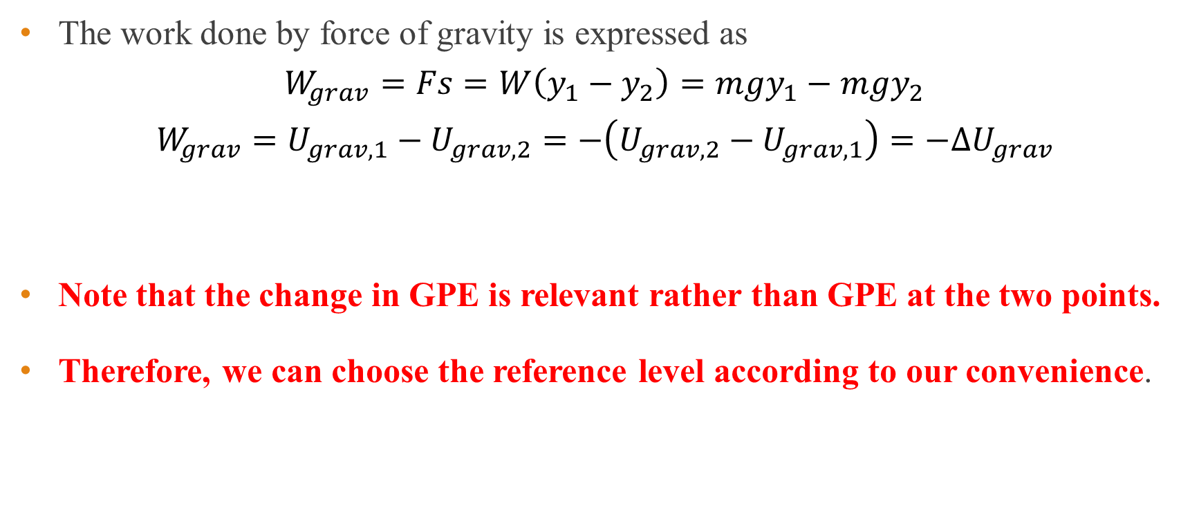
Work and Gravitational Potential Energy
The work done by force of gravity is expressed as
$$W_{grav}=Fs=W\left(y_{1}−y_{2}\right)=mgy_{1}−mgy_{2}$$
$$W_{grav}=U_{grav,1}−U_{grav,2}=−\left(U_{grav,2}−U_{grav,1}\right)=−ΔU_{grav}$$
Note that the change in GPE is relevant rather than GPE at the two points.
Therefore, we can choose the reference level according to our convenience.
Notes:
The above expression is true even if the body moves upward.

Slide 19
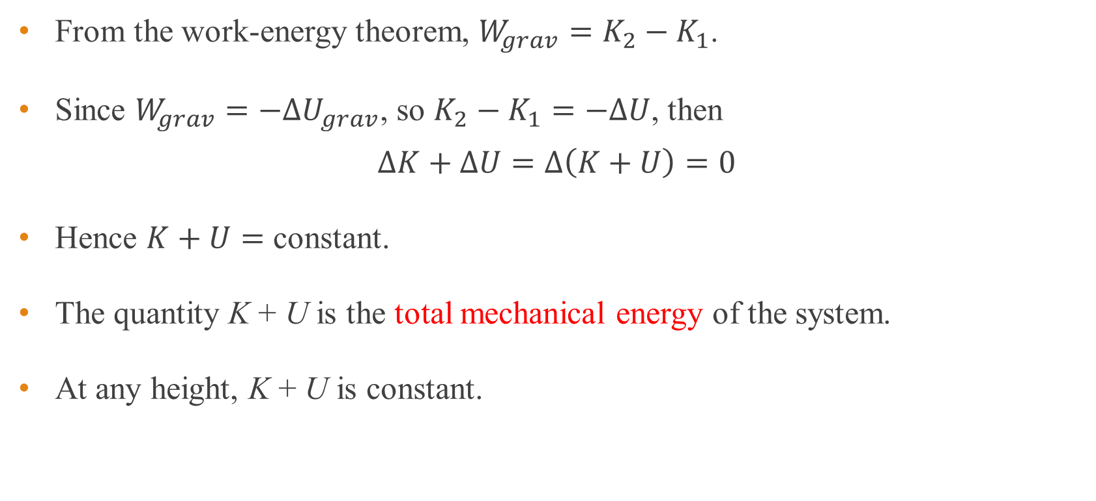
Conservation of mechanical energy
From the work-energy theorem, $W_{grav}=K_{2}−K_{1}$.
Since $W_{grav}=−ΔU_{grav}$, so $K_{2}−K_{1}=−ΔU$, then
$$ΔK+ΔU=Δ\left(K+U\right)=0$$
Hence $K+U=$ constant.
The quantity K + U is the total mechanical energy of the system.
At any height, K + U is constant.

Slide 20
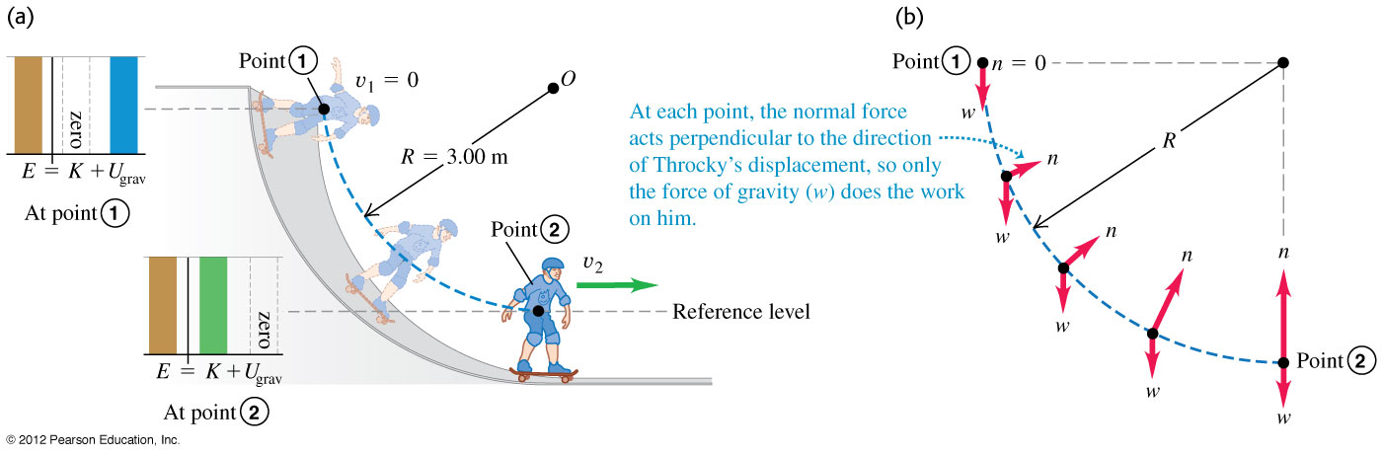
Example 5
A man skateboards from rest down a curved, frictionless ramp. If we treat the man and his skateboard as a particle, he moves through a quarter circle with radius R = 3.00 m (see figure). The mass of the person and the skate board is 25.0 kg. (a) Find his speed at the bottom of the ramp and (b) Find the normal force that acts on him at the bottom of the curve.

Slide 21
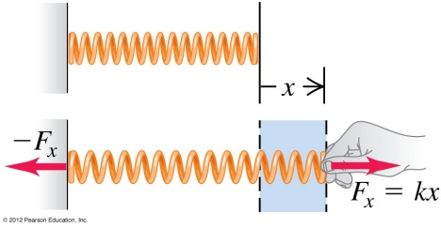
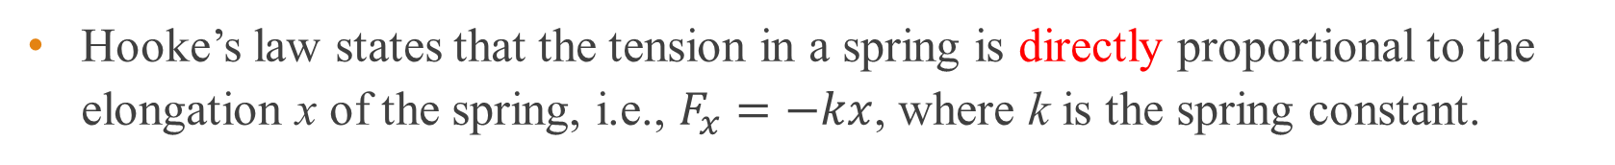
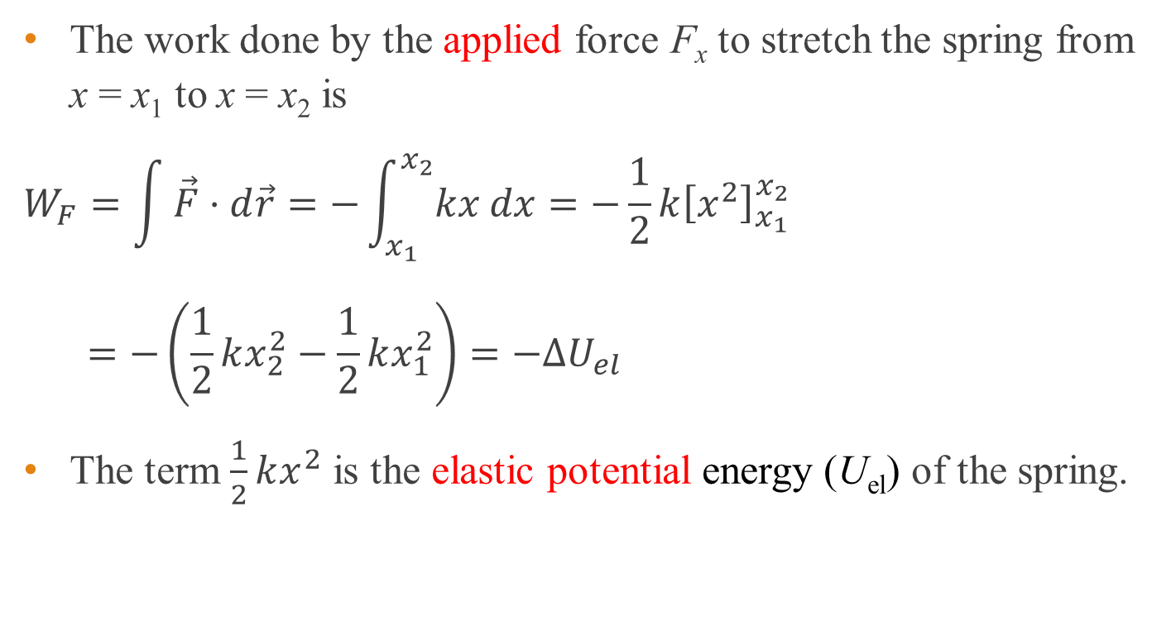
Elastic potential energy
Hooke’s law states that the tension in a spring is directly proportional to the elongation x of the spring, i.e., $F_{x}=−kx$, where k is the spring constant.
The work done by the applied force F_{x} to stretch the spring from x = x₁ to x = x₂ is
$$W_{F}=\int{\vec{F}⋅d\vec{r}}=−\int_{x_{1}}^{x_{2}}{kx dx}=−\frac{1}{2}k{\left[x^{2}\right]}_{x_{1}}^{x_{2}}$$
$$=−\left(\frac{1}{2}kx_{2}^{2}−\frac{1}{2}kx_{1}^{2}\right)=−ΔU_{el}$$
The term $\frac{1}{2}kx^{2}$ is the elastic potential energy (U_{el}) of the spring.

Slide 22
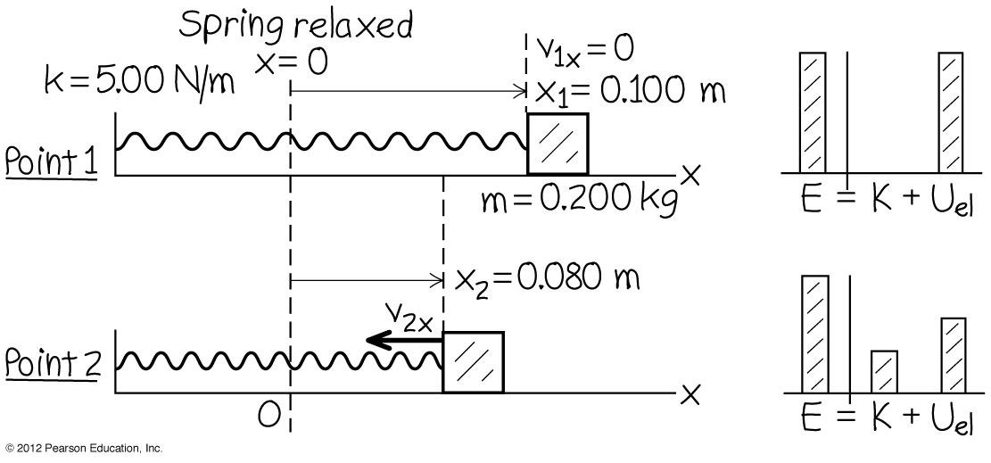
Example 6
A mass of 0.200 kg sits on a frictionless horizontal surface connected to a spring with force constant 5.00 N/m. The mass is pulled so that it stretches the spring 0.100 m and then released from rest. The mass moves back toward it equilibrium position. What is its x-velocity when x = 0.080 m?

Slide 23
Conservative systems and forces
Systems where the total mechanical energy is conserved are known as conservative systems.
The forces which act in a conservative system are known as conservative forces.
Examples of conservative forces are gravity and tension in a spring.

Slide 24
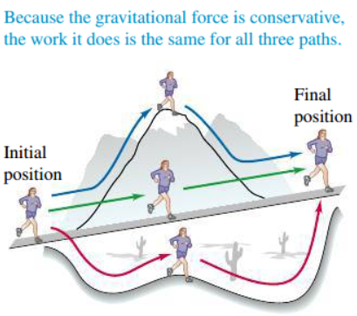
Work done by a conservative force
The work done by a conservative force can be expressed as the difference between the initial and final values of a potential energy function.
It is independent of the path taken by the object.
When the start and the end points are the same, the total work done by the conservative force is zero.

Slide 25
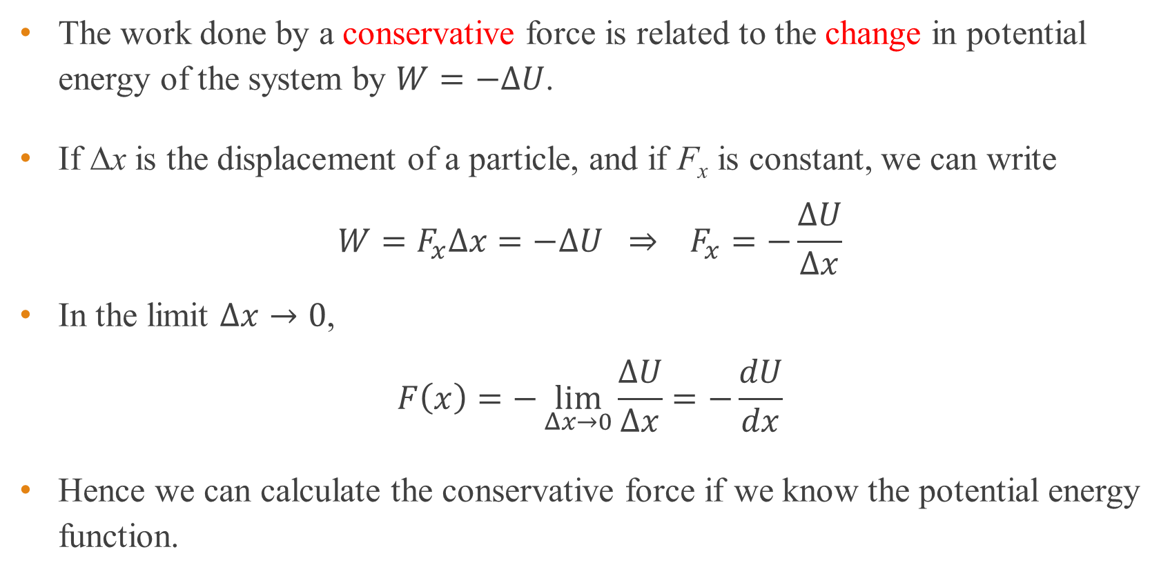
Conservative force and potential energy
The work done by a conservative force is related to the change in potential energy of the system by $W=−ΔU$.
If ∆x is the displacement of a particle, and if F_{x} is constant, we can write
$$W=F_{x}Δx=−ΔU ⇒ F_{x}=−\frac{ΔU}{Δx}$$
In the limit $Δx→0$,
$$F\left(x\right)=−\lim_{Δx→0}{\frac{ΔU}{Δx}}=−\frac{dU}{dx}$$
Hence we can calculate the conservative force if we know the potential energy function.

Slide 26
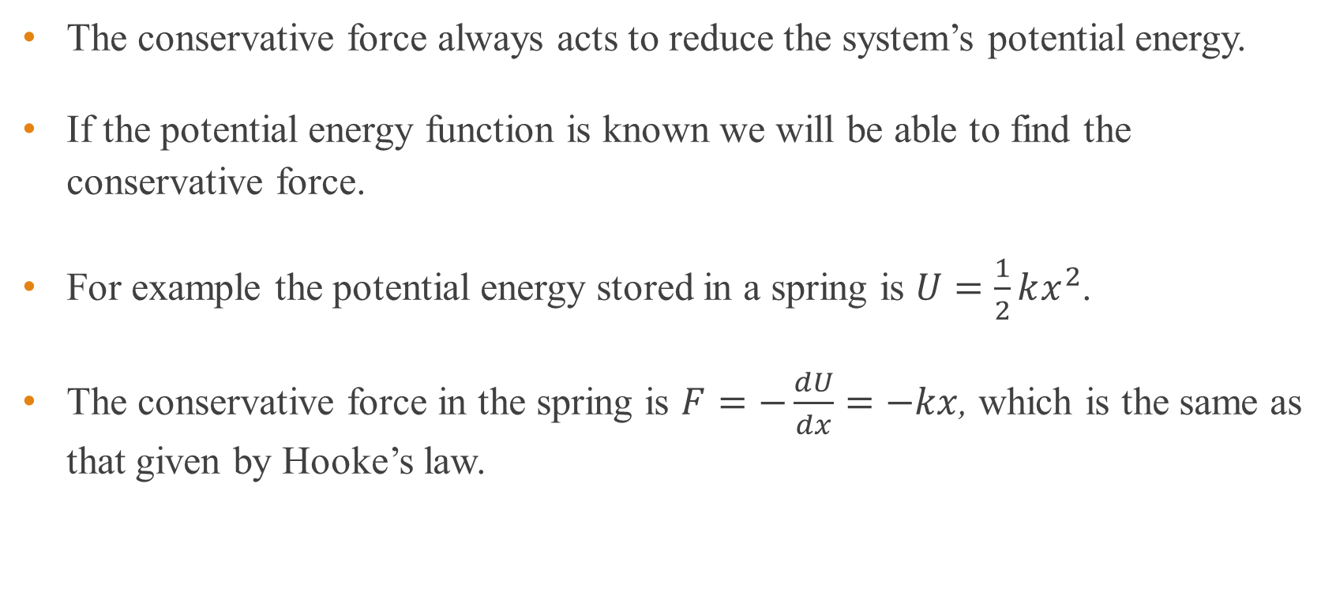
Conservative force and potential energy
The conservative force always acts to reduce the system’s potential energy.
If the potential energy function is known we will be able to find the conservative force.
For example the potential energy stored in a spring is $U=\frac{1}{2}kx^{2}$.
The conservative force in the spring is $F=−\frac{dU}{dx}=−kx$, which is the same as that given by Hooke’s law.

Slide 27
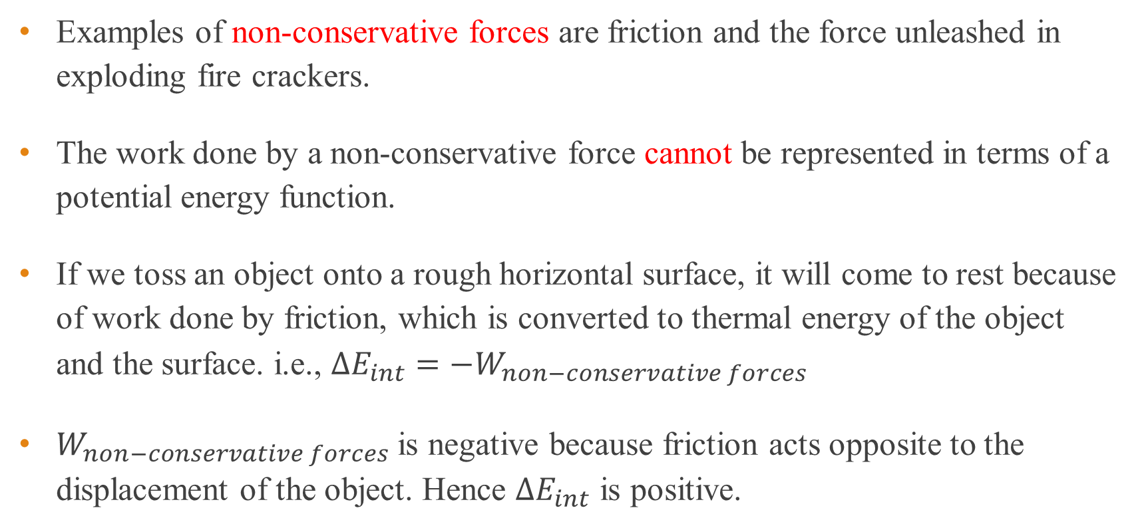
Non-conservative force
Examples of non-conservative forces are friction and the force unleashed in exploding fire crackers.
The work done by a non-conservative force cannot be represented in terms of a potential energy function.
If we toss an object onto a rough horizontal surface, it will come to rest because of work done by friction, which is converted to thermal energy of the object and the surface. i.e., $ΔE_{int}=−W_{non−conservative forces}$
$W_{non−conservative forces}$ is negative because friction acts opposite to the displacement of the object. Hence $ΔE_{int}$ is positive.

Slide 28
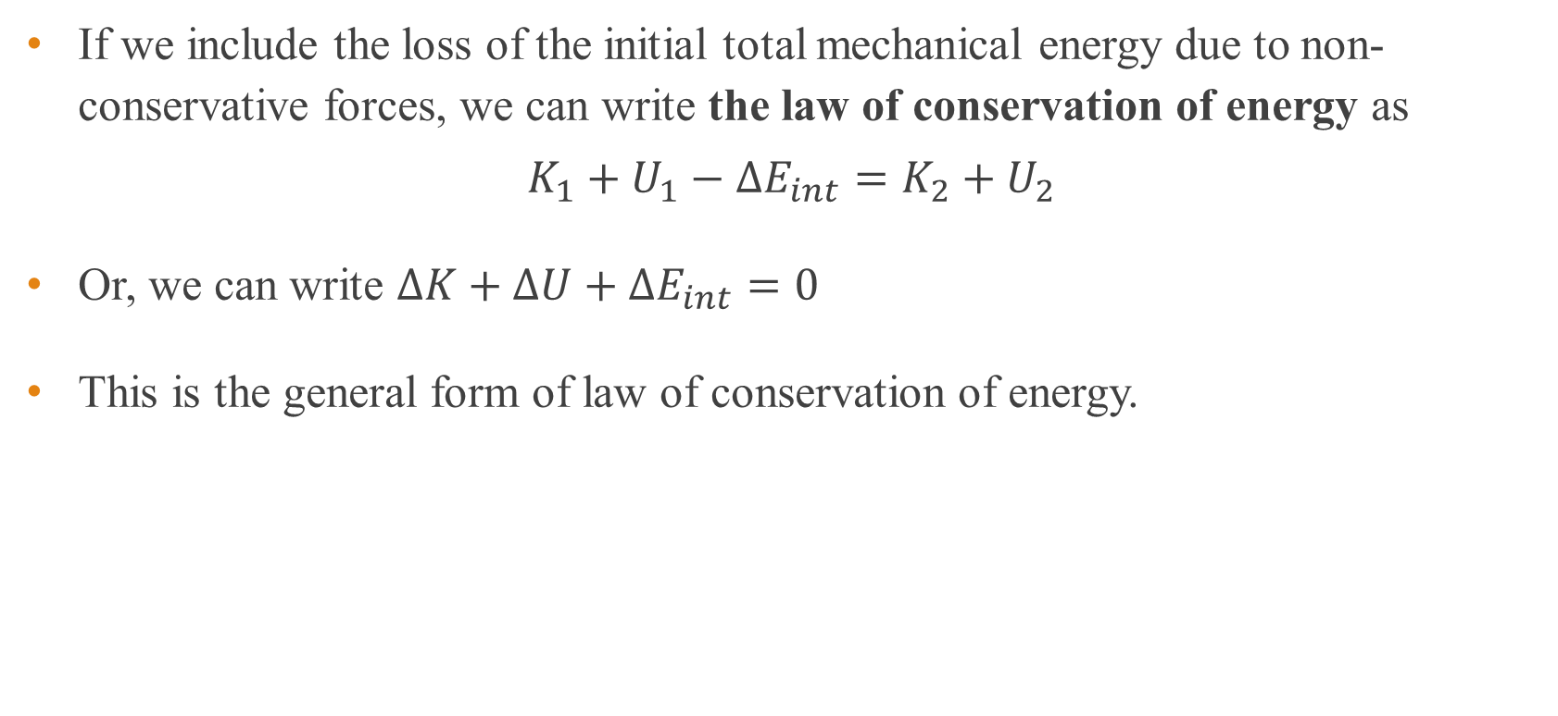
Non-conservative force
If we include the loss of the initial total mechanical energy due to non-conservative forces, we can write the law of conservation of energy as
$$K_{1}+U_{1}−ΔE_{int}=K_{2}+U_{2}$$
Or, we can write $ΔK+ΔU+ΔE_{int}=0$
This is the general form of law of conservation of energy.

Slide 29
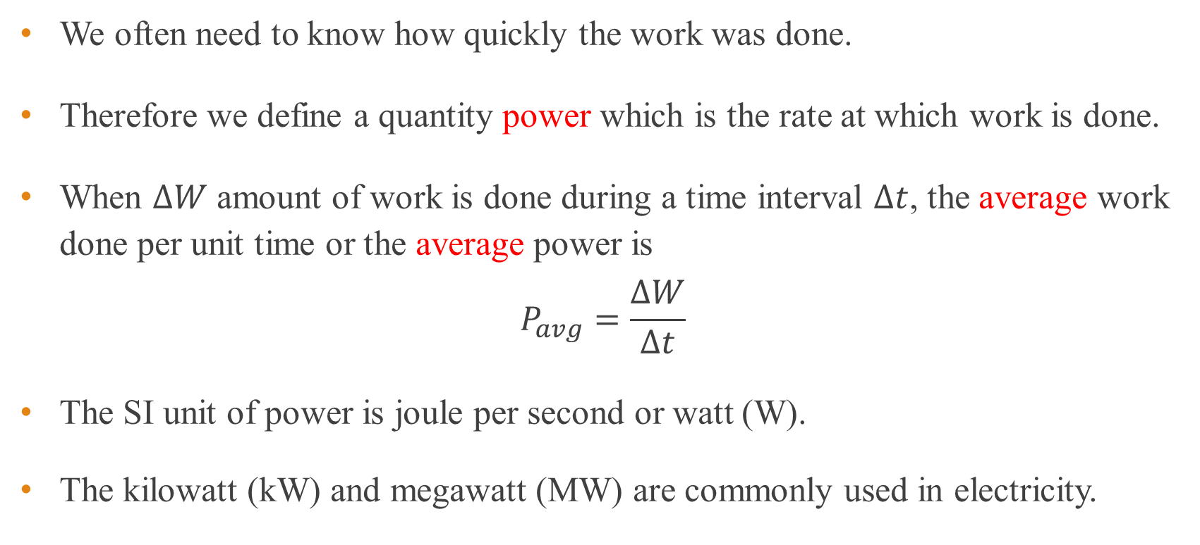
Power
We often need to know how quickly the work was done.
Therefore we define a quantity power which is the rate at which work is done.
When $ΔW$ amount of work is done during a time interval $Δt$, the average work done per unit time or the average power is
$$P_{avg}=\frac{ΔW}{Δt}$$
The SI unit of power is joule per second or watt (W).
The kilowatt (kW) and megawatt (MW) are commonly used in electricity.

Slide 30
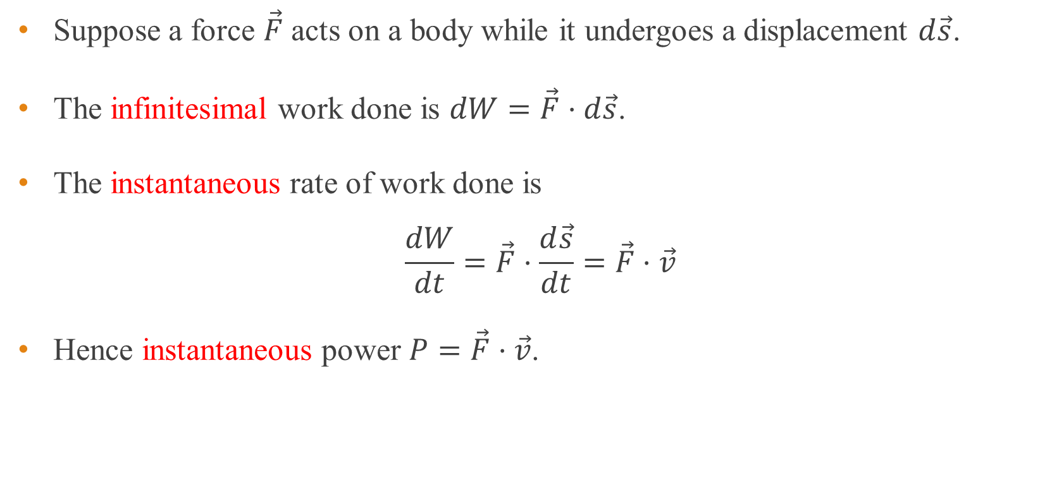
Power in terms of force and velocity
Suppose a force $\vec{F}$ acts on a body while it undergoes a displacement $d\vec{s}$.
The infinitesimal work done is $dW=\vec{F}⋅d\vec{s}$.
The instantaneous rate of work done is
$$\frac{dW}{dt}=\vec{F}⋅\frac{d\vec{s}}{dt}=\vec{F}⋅\vec{v}$$
Hence instantaneous power $P=\vec{F}⋅\vec{v}$.

Slide 31
Example 7
A 50.0-kg marathon runner runs up the stairs to the top of Chicago’s Willis tower whose height is 443 m. To lift herself to the top in 15.0 minutes, what must be her average power output?

Slide 32
Domestic unit of power
The domestic unit of electricity is the kilowatt-hour (kWh).
One kWh is the energy used by a device at a rate of 1000 watts in one hour.
1 kWh = 1000 W × 3600 s = 3.6 × 10⁶ J = 3.6 MJ.
The cost of electricity is based on the number of kilowatt-hour (kWh) of electrical energy used.

Slide 33
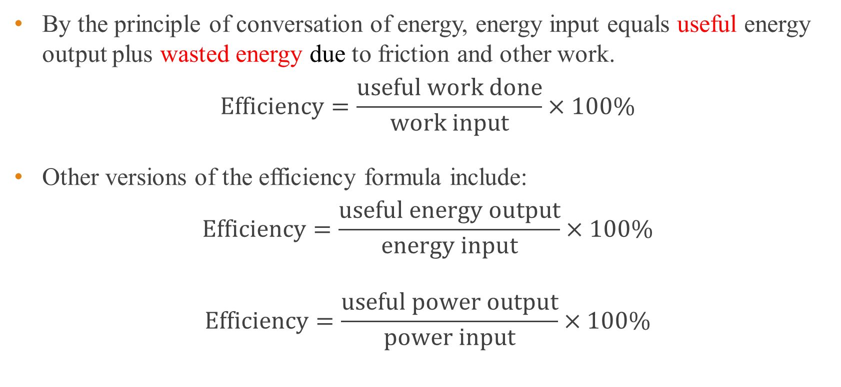
Efficiency of machines
By the principle of conversation of energy, energy input equals useful energy output plus wasted energy due to friction and other work.
$$\text{Efficiency}=\frac{\text{useful} \text{work} \text{done}}{\text{work} \text{input}}×100\%$$
Other versions of the efficiency formula include:
$$\text{Efficiency}=\frac{\text{useful} \text{energy} \text{output}}{\text{energy} \text{input}}×100\%$$
$$\text{Efficiency}=\frac{\text{useful} \text{power} \text{output}}{\text{power} \text{input}}×100\%$$

Slide 34
Useless work
The useful work is the work done in raising the load.
In the double pulley system shown below, the lower pulley and rope have weight and work must be done to raise them in order to lift the load.
The work done to raise the lower pulley and rope are useless work.
Load

Slide 35
End of chapter

